Slide 1
IST 263
JavaScript Part 2

Slide 2
AGENDA
Project Milestone 6 – First Draft
DOM
Access DOM Nodes
Manipulating Nodes
Hamburger Menu

Slide 3
DOM

Slide 4
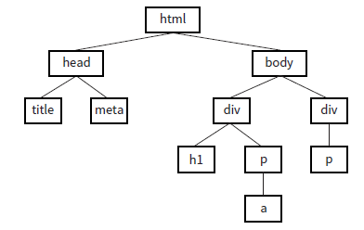
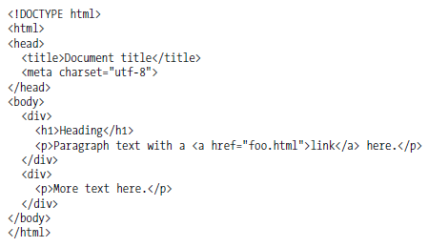
Reviewing the DOM (Document Object Model)

Slide 5
What is a node?
Each element on the page is referred to as a node.
The attributes inside the tags are nodes.
Content inside the elements are nodes.
We can use these nodes to change things and make our pages dynamic.

Slide 6
Accessing DOM Nodes

Slide 7
document
In JavaScript “document” identifies the web page. When you are identifying an object on the page you start with document. After that you can chain together different methods in JavaScript to select nodes.

Slide 8
DOM Node Locations
document.getElementById("messages")
refers to whole web page
Says to look at the id attributes in the tags
value in the id attribute

Slide 9
Common DOM Methods
Searching for? | How do you find that? | What it locates
ID | document.getElementById("myid") | elements with an id of myid like <p id="myid">Hello</p>
Element | document.getElementsByTagName("p") | p elements like <p>Hello</p>
Form Value | document.getElementById("myformid").value | form elements with id of myformid like <input type="text" id="myformid">
Elements style value | document.getElementById("myid").style.getPropertyValue("width") | The value of the css width property for an element with the id of myid.
Elements style value | document.getElementById('navlinks').style.display | Allows you to change the CSS property’s value

Slide 10
Manipulating Nodes

Slide 11

How do we change the page dynamically?

Slide 12
innerHTML
Put your DOM node together with innerHTML:
document.getElementById("myid").innerHTML = "<p>Hello World</p>";
locates element with id="myid"
what we are changing
value after change

Slide 13
setAttribute()
Put your DOM node together with setAttribute:
document.getElementById("myid").setAttribute("src", "lespaul.jpg");
locates element with id="myid"
what we are changing
attribute name an its value after change

Slide 14
style
Put your DOM node together with style:
document.getElementById("myid"). style.color = "#000000";
locates element with id="myid"
what we are changing
property and value after change
Note: CSS properties with hyphens are replaced with camel case so background-color = backgroundColor in JavaScript.

Slide 15
Hamburger Nav

Slide 16
Review Locators
Searching for? | How do you find that? | What it locates
Elements style value | document.getElementById("myid").style.getPropertyValue("width") | The value of the css width property for an element with the id of myid.
Elements style value | document.getElementById('navlinks').style.display | Allows you to change the CSS property value

Slide 17
Participation

Slide 18
Participation 12
Create a new page
Use a div tag
Write “Syracuse University” inside
When clicked change the text to “Orange Nation” and Change text color to orange
Upload Code to Participation 12

